Slide 1






TEMPO Validation
Overview and Plans
Mike Newchurch and the
TEMPO validation team
6-7 June 2018
6th TEMPO Science Team Meeting
NCAR
Boulder, CO

Slide 2
Current TEMPO Validation Team
All are welcome
Science Team | Collaborators
Mike Newchurch/O₃ Jay Al-Saadi/Aircraft sims Ron Cohen/NO₂ Dave Flittner/Calibration Jay Herman/Pandora Xiong Liu/Retrievals Randal Martin Chris McLinden Chris Chan Miller Jim Szykman/H₂CO Brad Pierce Luke Valin | Jim Crawford/Campaigns Manvendra Dubey/TCCON NO₂, HCHO. Pandora Jeffrey Geddes/Pandora Dr. Michel Grutter de la Mora/Pandora, Max DOAS Tom Hanisco/H2CO. Laura T. Iraci/Alpha Jet Elena Lind/ Pandora HCHO Debra Wunch/TCCON H₂CO, O₃, and NO₂

Slide 3
PLRA Section 4.1.1.b
Baseline Cal/Val
Purpose: identify and correct regional-scale and diurnal systematic biases in the space-based products and demonstrate required precisions in polluted clear-sky scenes to the levels listed in the PLRA Table
Approach: Compare space-based and ground-based retrievals of products using correlative data collected from:
  daytime (solar zenith angles <70° for all products) observations
  at least one month each season
  from at least three (3) ground validation sites in the US
At the validation sites, Pandora solar spectral-radiometer measurements will be the primary source of correlative data for trace gas column densities.
Ozonesondes and TOLNet will contribute to the validation of the O3 mixing ratio on a best-effort basis.

Slide 4
PLRA 4.1.1 and 4.1.2
Baseline and threshold data products
Implementation of SO₂, C₂H₂O₂, and aerosols delayed until instrument cost and schedule risks retired
Likely ~October 2015
Derived UVB also delayed
All still ready for launch if successful
Clouds being implemented at present
Species/Products | Required Precision | Temporal Revisit
0-2 km O₃ (Selected Scenes) Baseline only | 10 ppbv | 2 hour
Tropospheric O₃ | 10 ppbv | 1 hour
Total O₃ | 3% | 1 hour
Tropospheric NO₂ | 1.0 × 10¹⁵ molecules cm⁻² | 1 hour
Tropospheric H₂CO | 1.0 × 10¹⁶ molecules cm⁻² | 3 hour
Tropospheric SO₂ | 1.0 × 10¹⁶ molecules cm⁻² | 3 hour
Tropospheric C₂H₂O₂ | 4.0 × 10¹⁴ molecules cm⁻² | 3 hour
Aerosol Optical Depth | 0.10 | 1 hour
PLRA Table 1
Minimal set of products sufficient for constraining air quality
Across Greater North America (GNA): 1819°N to 5857.5°N near 100°W, 67°W to 125°W near 42°N (worst case combo of instrument and host pointing; best case still 18-58)
Data products at urban-regional spatial scales
  Baseline ≤ 60 km² at center of Field Of Regard (FOR)
  Threshold ≤ 300 km² at center of FOR
Temporal scales to resolve diurnal changes in pollutant distributions
Collected in cloud-free scenes
Geolocation uncertainty of less than 4 km
Mission duration, subject to instrument availability
  Baseline 20 months
  Threshold 12 months

Slide 5
Validation Side Note
TEMPO Level 1b Radiance product has no PLRA requirement, and hence no validation promise.
However, it will be evaluated to the extent necessary to produce the Level 2 Baseline data products.
Evaluation will most likely rely upon measurement vs. radiative transfer model comparisons.
If radiance measurements from other appropriate space-based instruments, i.e. TropOMI, or air-borne instruments, i.e. GEOTaso, are available they’ll also be examined.
Likewise, validation of the cloud product is not a PLRA requirement, but it will be evaluated as an intermediate product in the Level 2 processing.

Slide 6

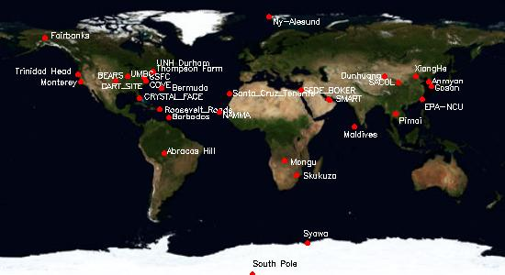
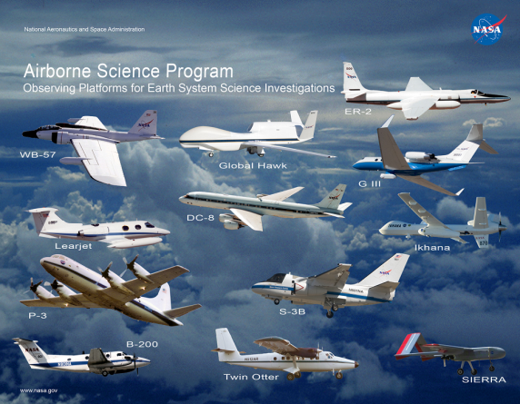
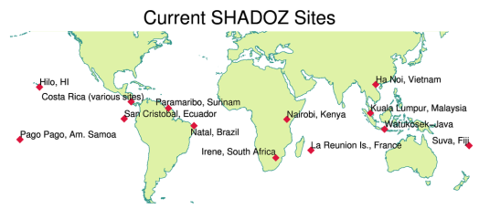
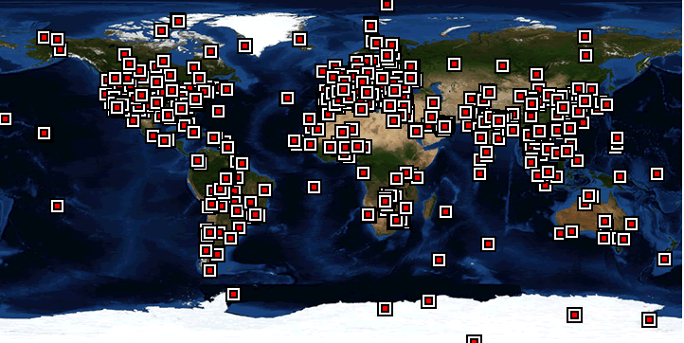
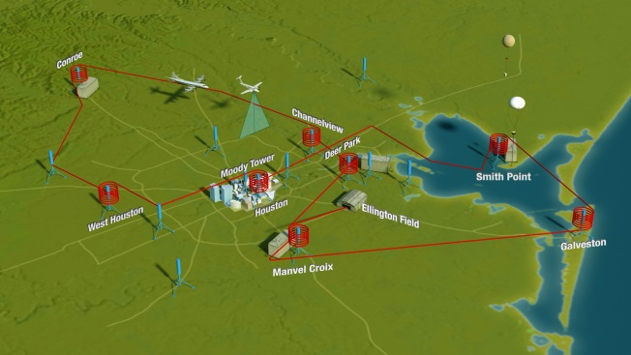
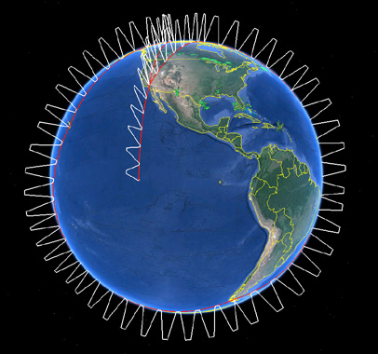
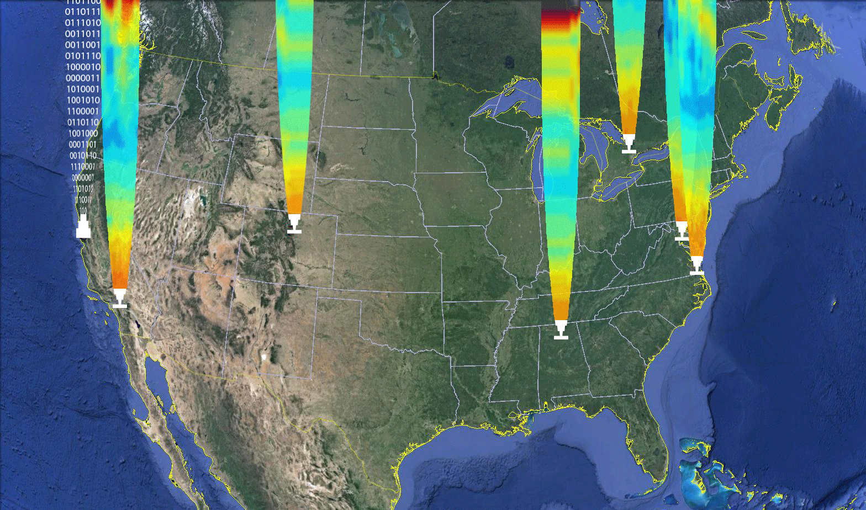
Examples of Contributing Activities
Surface-Based Measurement Networks
NASA Airborne Science Fleet
MPLNet
SHADOZ
DISCOVER-AQ Mission
AToM Mission
AERONET
TOLNet
TORONTO
AMES
ESRL
GSFC
Tropospheric Ozone LIDAR Network
JPL
LaRC
UAH

Slide 7
Context: What we would like to do
Objective: Validate Baseline products: L-1b radiances, NO2, O3, SO2, C2H2O2, HCHO, AOD, AAOD, Cloud Fraction, Cloud-top Pressure, Geo-location accuracy
  Development uncertainty estimates of PBL mixing-ratios
  Establish data credibility within the Air-Quality Community
Mindset: Hourly 5x5 km observations.
  Think high-resolution temporal and spatial evolution
  Work to overcome limited vertical resolution
Details:
  PLRA table Products and schedule and GSICS: Dave Flittner
  Federated activities leverage (PAMS/NCore, CASTNet, CSN, and IMPROVE), along with research networks SPARTAN and BEACO2N, along with Canadian and Mexican assets.): Jim Szykman
  Modeled/measured radiances: Brad Pierce & Chris Chan-Miller
  Pandora columns and vertical information: Jay Herman
  Surface remote-sensing/profiling networks and research sites: TOLNet, NDACC, Pandora, Ozonesonde, Brewer/Dobson, CAPABLE, AIRS, NAPS (Canada), and Mexican assets
  Aircraft campaigns: Jay Al-Saadi and Jim Crawford
  ACAM/GCAS/Geo-TASO: Liu/Abad
  A/C validation of OMI H₂CO : Abad
  Space-borne instruments including OMI, GOME-2, NPP/OMPS, TROPOMI, and Sentinel 5
Validation plans:
  H₂CO: Jim Szykman/Herman
  NO₂: Ron Cohen
  O₃: Mike Newchurch
  International collaborations/intercomparisons: Korean Geostationary Environmental Monitoring Spectrometer (GEMS) providing O3, NO2, H2CO, SO2, and aerosol products, the European Sentinel 4 and 5P missions providing O3, NO2, H2CO, C2H2O2, SO2, H2O, and aerosol products, the NASA/NOAA NPP/OMPS providing O3, and the Global Space-based Inter-calibration System (GSICS). Newchurch/Al-Saadi/Liu/Abad

Slide 8
Validation ideas
Remote continental locations at middle latitudes with homogeneous and easily predictable surface reflectivity, simple homogeneous landscape, low cloud cover. These sites are important for validation of satellite retrievals under favorable conditions. In addition, they can provide long-term measurements of mainly stratospheric NO2 and O3 columns.
Remote continental locations at middle latitudes with less favorable satellite retrieval conditions
Multiple validation instruments within heterogeneous locations such as big cities, coastal areas, city edges, etc.
High latitudes with challenging SZA and reflectivity's etc.
Examine repeats at a power plant with near-constant emissions and check that there is little variation of NO₂ with time of day.

Slide 9
Validation ideas
TEMPO Validation Workshop
2017 April 26 and 27, David Brower Center, Berkeley, CA
Workshop Goals
Identify validation strategies that will quickly find programming and other simple retrieval mistakes in the early days of TEMPO.
Summarize strategies for validation that were effective at challenging and then guiding improvements to retrieval assumptions/algorithms for previous related space-based instruments
Identify strategies for testing the SZA dependence of the retrieval. Which aspects of SZA variations have been tested with the current array of LEO instruments? What new aspects are to be evaluated?
Identify strategies for testing the novel high-spatial-resolution aspects of the retrieval.

Slide 10
Some outcomes of the 2017 Validation Meeting:
Validate the Pandora retrievals.
Need a mix of urban and rural sites for Pandoras.
Synchronize Pandora sun angle and TEMPO stare times.
Need some homogeneous (desert? Chesapeake Bay?) sites for baseline.
Car-mounted Pandora for sub-pixel variability.
Co-locate with surface NO2, O3, H2CO.
Need some profile information to assess retrieval accuracy (TOLNet).
Use GEO-TASO over flights.
Satellite (TROPOMI) intercomparisons.
For ozone, ancillary measurements will help: ozonesonde, lidar, Dobson/Brewer.
Correctly characterizing PBL/SFC ozone presents many challenges.

Slide 11
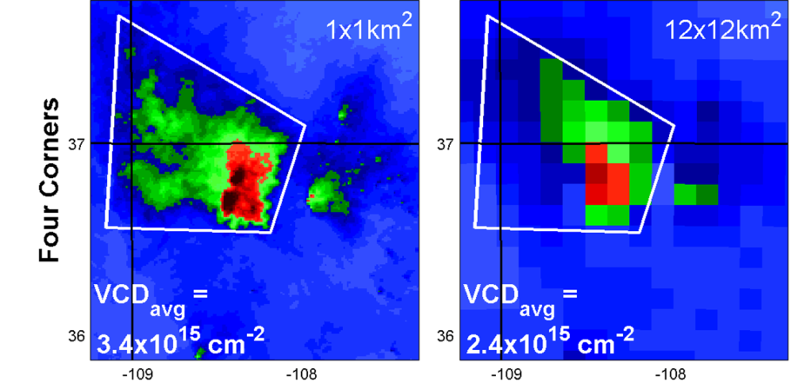
Resolution matters
L Valin et al., GRL 2013

Slide 12
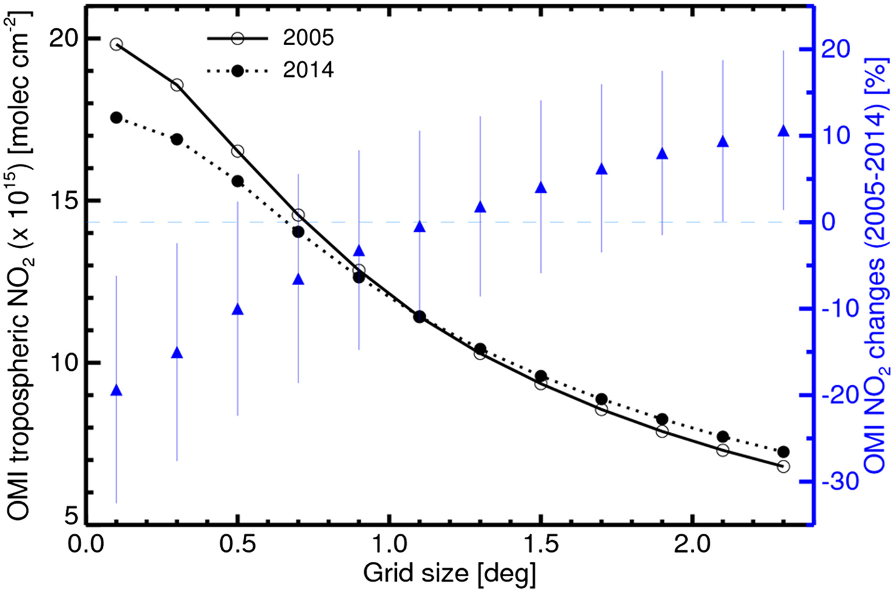
Resolution matters
e.g., Duncan et al. JGR 2016

Slide 13


Jay Herman
Bob Swap

Slide 14
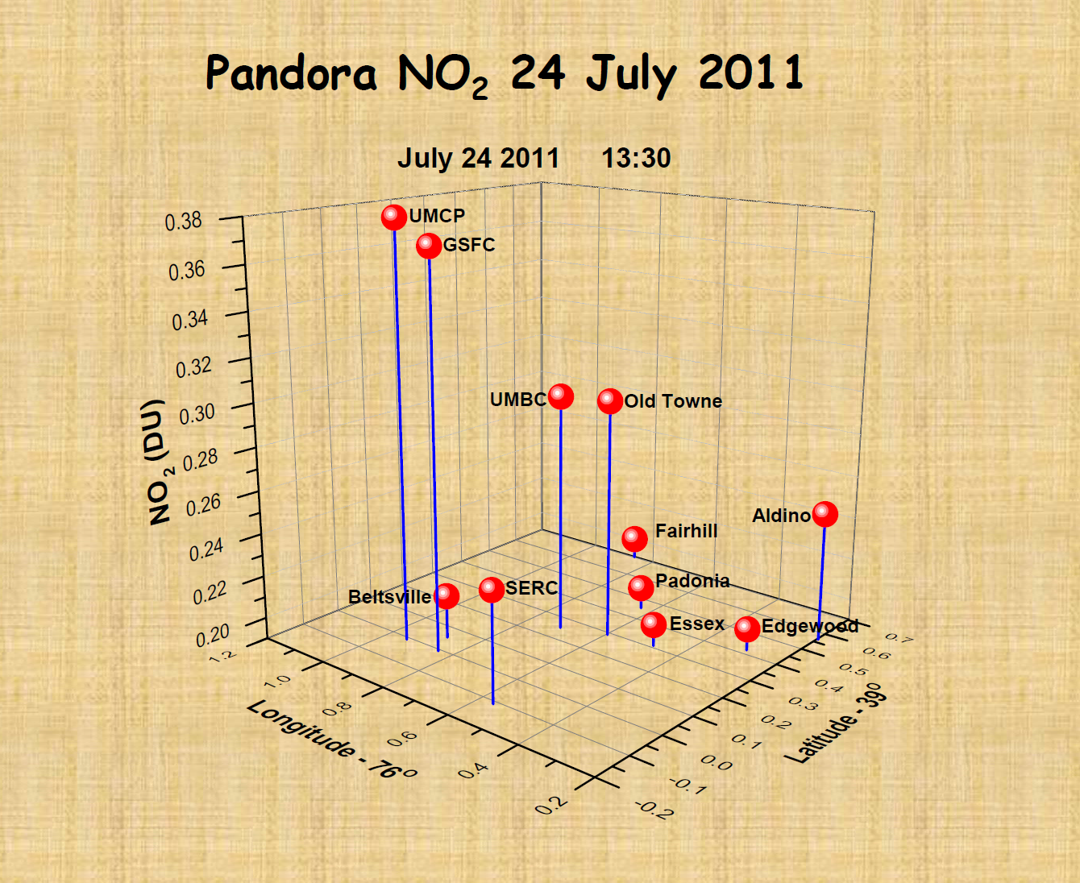
NO₂ variation during D-AQ NE

Slide 15
Pandora Locations
Current sites: See Bob Swap Pandora talk.
By end of 2018?

Slide 16
Ozone

Slide 17
Validation Approach
TEMPO ozone products
Total ozone column
0-tropopause
0-2km
Traditional satellite validation for total ozone column
Multiple pairwise comparisons
Ozonesondes
Ozone lidars
Brewer and Dobson spectrophotometers
a/c profiles
Satellite intercomparisons
Assets
3 or 4 US plus a few Canadian ozonesonde stations
Additional episodic launches.
6 TOLNet ozone lidars
~dozen Brewers
AJAX profiles
TROPOMI, OMPS,
In situ surface networks

Slide 18
Validation Approach
Calculations
Univariate statistics
Spatial-temporal patterns
EOF analyses
SVD calculations
Structure function
Deviations from a priori
TEMPO aspects in addition to traditional total column
Cloud clearing approach
SZA dependence
Diurnal variation
Column separation
Surface-PBL correlation
Surface albedo
PBL aerosol interference
Assets to address these issues
Diurnal profiles by lidar or cutdown ozonesondes or Pandora
Ozone and aerosol profiles by lidar
Measure ozone and aerosol profiles at a variety of sites
Albedo (homogeneous or heterogeneous) measured by satellite or a/c

Slide 19
Role and Need for Aloft Measurements in
Model Development and Evaluation
Rohit Mathur, Jia Xing, Daiwen Kang, Christian Hogrefe, Jonathan Pleim
Computational Exposure Division
National Exposure Research Laboratory
U.S. Environmental Protection Agency
3rd Annual TOLNet Science Team Meeting
RTP, NC
June 28-30, 2016

Slide 20
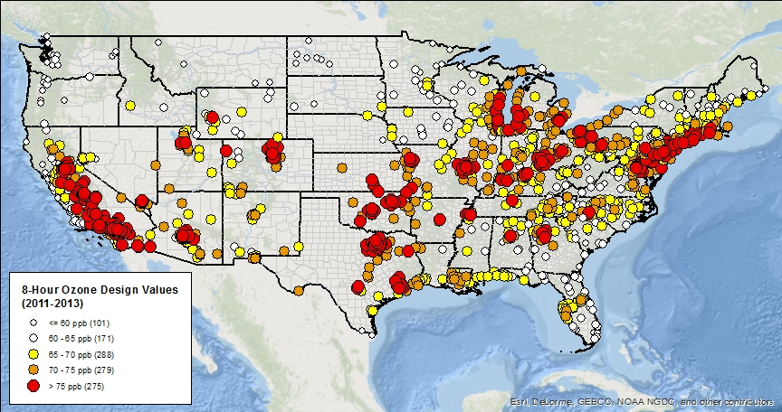
Motivation
2013 8-Hour Ozone Design Values across the U.S.
65-70ppb 70-75ppb >75ppb
Courtesy: P. Dolwick; (http://www.epa.gov/airtrends/values.html )
Tightening of air quality standards places greater emphasis on the ability of air quality models to simulate the entire spectrum of concentrations
The relative importance of “background pollution” to the NAAQS becomes more important
Notes:
Design values are defined to be consistent with the individual NAAQS & used for non-attainment classification; average of annual 4th highest over last 3 yrs.

Slide 21




Structure, Capabilities, and Accomplishments of the Tropospheric Ozone Lidar Network, TOLNet, for Background Ozone Determination
ENV-Vision; May 10-11, 2016; Washington D.C.
TOLNet
TORONTO
AMES
ESRL
GSFC
Tropospheric Ozone LIDAR Network
JPL
LaRC
UAH
Jack Kaye¹, Barry Lefer¹, Matthew Johnson², Thierry Leblanc³, Raul J. Alvarez II⁴, Guillaume Kirgis⁴, Andrew O. Langford⁴, Christoph J. Senff^{4,5}, Steve Brown⁴, Bryan Johnson⁴, John, F. Burris⁶, Shi Kuang⁶, Michael J. Newchurch⁶ ,Lihua Wang⁶, Kevin Strawbridge⁷, Thomas J. McGee⁸, John T. Sullivan⁸, Tim Berkoff⁹, Gao Chen⁹, Russell J. DeYoung⁹, Guillaume Gronoff⁹, Brad Pierce¹⁰, Terry Keating¹¹
¹NASA Headquarters, ²NASA Ames Research Center, ³NASA Jet Propulsion Laboratory
⁴NOAA Earth System Research Laboratory, ⁵University of Colorado at Boulder, ⁶University of Alabama in Huntsville, ⁷Environment and Climate Change Canada
⁸NASA Goddard Space Flight Center, ⁹NASA Langley Research Center, ¹⁰NOAA/NESDIS/STAR, ¹¹USEPA/OAR
Notes:
TOLNet members are listed:
1: HQ (they have the money)
2: Station teams listed from west to east by TOLNet tradition.
3: Alphabetical within station.
4: NOAA/NESDIS and ECCC (Canada) colleagues
AMES (1’s and 0’s beam) is the modeling center for TOLNet
JPL and UAH currently fixed site, UAH is preparing a mobile lab. TMF is thinking about one. All other stations (including Toronto, Canada) are mobile now.

Slide 22
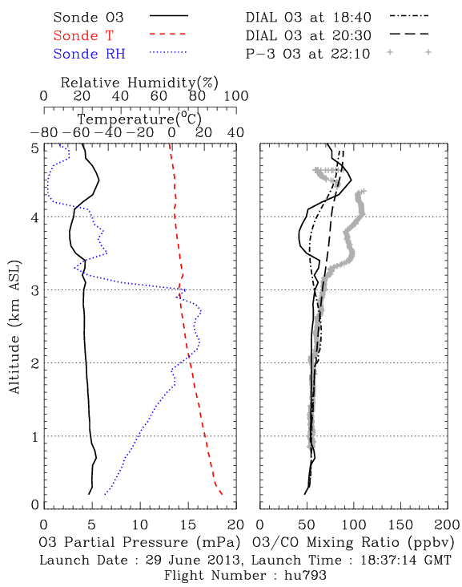
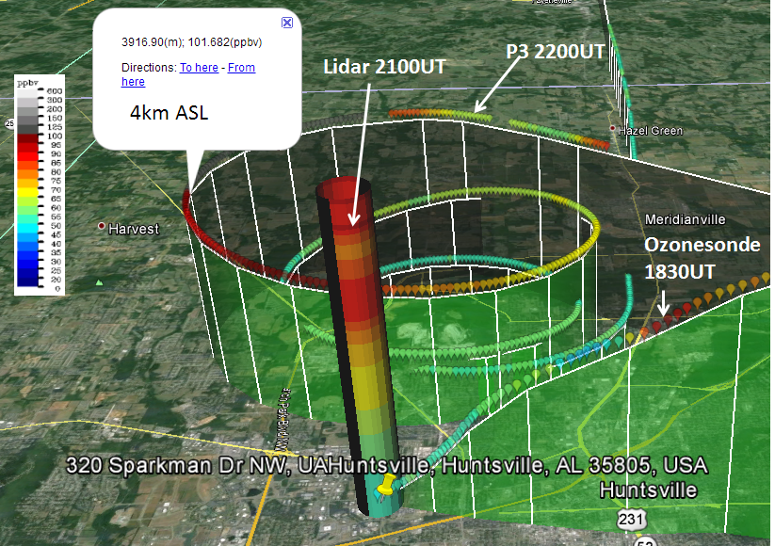
TOLNet/UAH RO₃QET validation with P-3B and ozonesondes during 2013 SENEX
TORONTO
AMES
ESRL
GSFC
JPL
LaRC
UAH
June 29, 2013
due to real ozone variations
Lidar, sonde, P-3 measured ozone mixing ratio shown on the GOOGLE map.
The left panel shows the ozone, temperature, and relative humidity measured by the ozonesonde launched at 18:37 showing atmospheric laminar structure. The right panel shows the comparison of ozone profile measured by the ozonesonde, the profile measured by the P-3, and two DIAL ozone profiles measured at two different times (one close to the ozonesonde launching time and the other close to the time P-3 overpassing Huntsville). <about 8 min for P-3 HSV spiral>
Notes:
UAH uses a combination of ozonesondes and aircraft observations to validate it ozone profiles. Spatial variability in x, y, and z pose continual challenges in accurately assessing the measurements and natural variability.

Slide 23
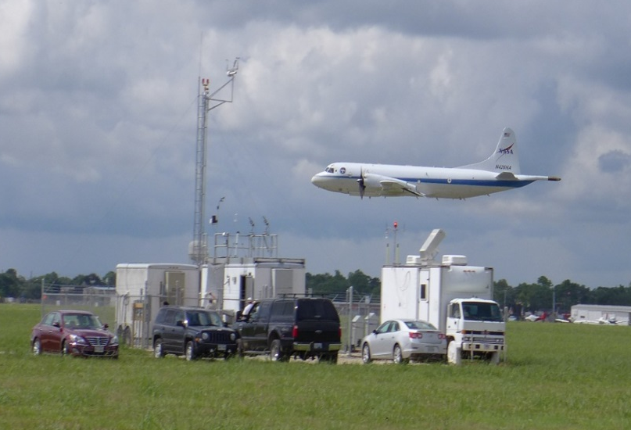
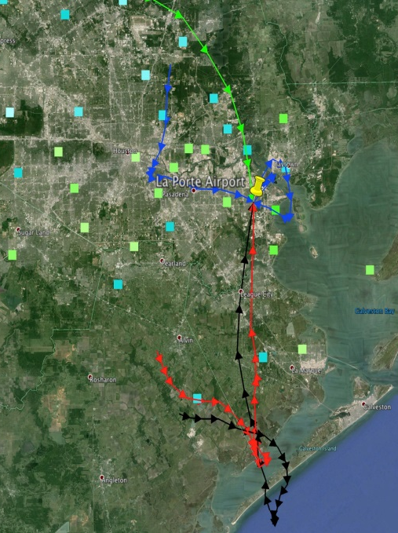
TOLNet/NOAA/ESRL TOPAZ
Land-sea breeze affects Houston ozone levels
TORONTO
AMES
ESRL
GSFC
JPL
LaRC
UAH
DiscoverAQ Houston: LaPorte Airport site
DiscoverAQ TX
25 Sep 2013
TCEQ met
tower
NASA P3-B
TOPAZ
lidar
EPA trailer
Light winds and recirculation of pollutants by the land-sea breeze led to very high afternoon O₃ concentrations.
Titration of O₃ in the shallow morning boundary layer was followed by a quick increase in O₃ due to photochemical production.
A rapid rise of the boundary layer around midday caused a temporary drop in O₃ levels as cleaner air from aloft was mixed down.
In the evening, the sea breeze brought in lower-O₃ air in the lowest few hundred m AGL, leaving a “dirty” residual layer aloft.
12-h wind profiler back trajectories
Notes:
Houston experiences significant land-sea breeze effects that comsprie with the local photochemistry to produce highly variable ozone amounts. Measurements of the vertical-temporal morphology by the TOLNet TOPAZ (ESRL) lidar help diagnose the processes responsible.

Slide 24
TOLNet/NOAA/ESRL TOPAZ
Evaluation of satellite-derived surface ozone
TORONTO
AMES
ESRL
GSFC
JPL
LaRC
UAH
DiscoverAQ Colorado: 29 Jul 2014
Surface vs column O₃: 4 field studies
surface vs. column O₃
TOPAZ lidar measurements close to the surface and surface-to-2km lidar O₃ column averages from four different field studies were compared to assess the ability of future satellites (e.g. TEMPO) to measure surface O₃ by way of lower-atmosphere column observations.
Column and surface O₃ observations typically agree from mid-day through the afternoon, when the boundary layer is usually well mixed. Biases occur when significant O₃ gradients are present in the lower troposphere, due to, e.g., a shallow mixed layer or low-level advection of different air masses by thunderstorm outflows or the sea breeze.
Notes:
TOLNet lidars help evaluate the correspondence between satellite observation and surface conditions. The correspondence changes throughout the diurnal cycle of the PBL development/decay.

Slide 25


TORONTO
TOLNet/NASA/GSFC TROPOZ
PBL Ozone in Beltsville, MD 2015
GSFC
AMES
ESRL
LaRC
JPL
UAH
TROPOZ characterizing high O₃ during Summer 2015 in BW region
Smoke?
Residual Ozone Layer
Well mixed 90 – 120 ppbv ozone in PBL
Ozonesonde
Ozonesonde
Surface Monitor
Top: The GSFC TROPOZ was deployed to Beltsville, MD to make measurements in support of Maryland Department of the Environment (MDE) air quality forecasts. On June 10, 2015 (one day before above time-series) heavy smoke originating from Canadian wildfires (most likely from Saskatchewan) impacted the boundary layer throughout the Mid-Atlantic region, bringing additional ozone precursors to the region. The ozone series on June 11, 2015 (above) shows large ozone enhancement with ozone concentrations reaching 90-120 ppbv, which were also verified with the ozonesonde. The impacts at the surface were also observed and several surface monitoring sites, including the Beltsville, MD monitor, exceeded the NAAQS 8-hr 75 ppbv ozone standard. Importantly, this was the worst day for ozone in MD since 2012.
Notes:
Example from TROPOZ in Beltsville, MD measuring high ozone in the PBL during the day and the resulting nighttime residual layer of high ozone that affects the next day’s PBL and surface amounts. In conjunction with MD Dept. of Environment.

Slide 26
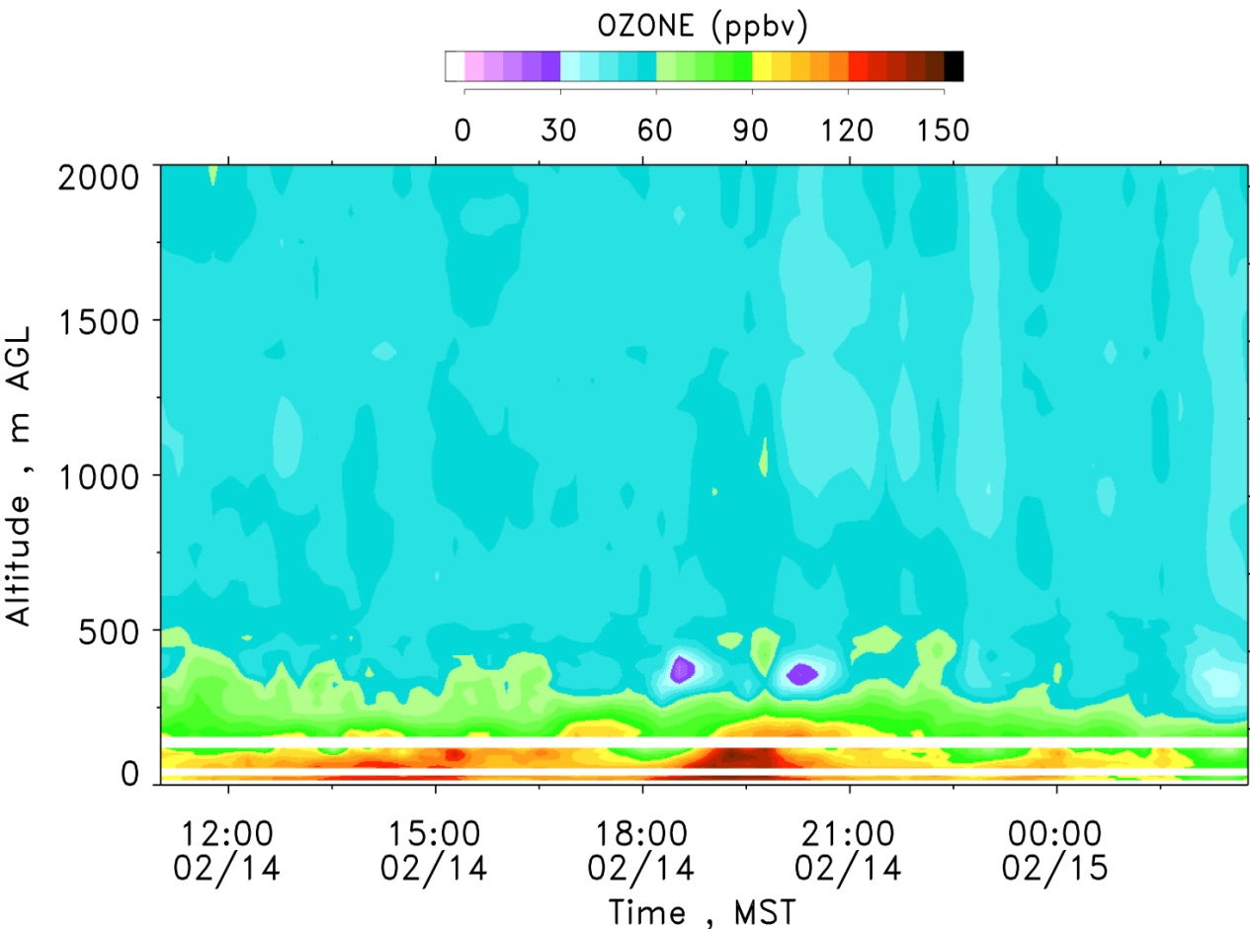
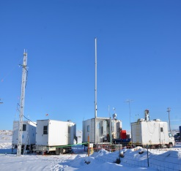
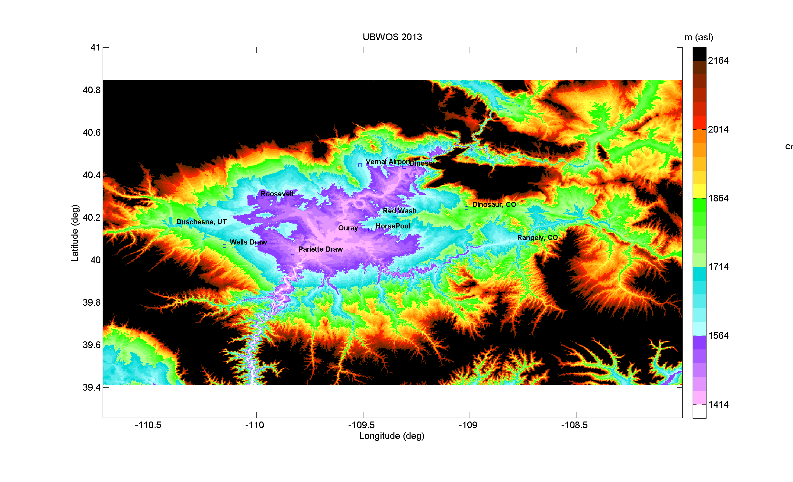
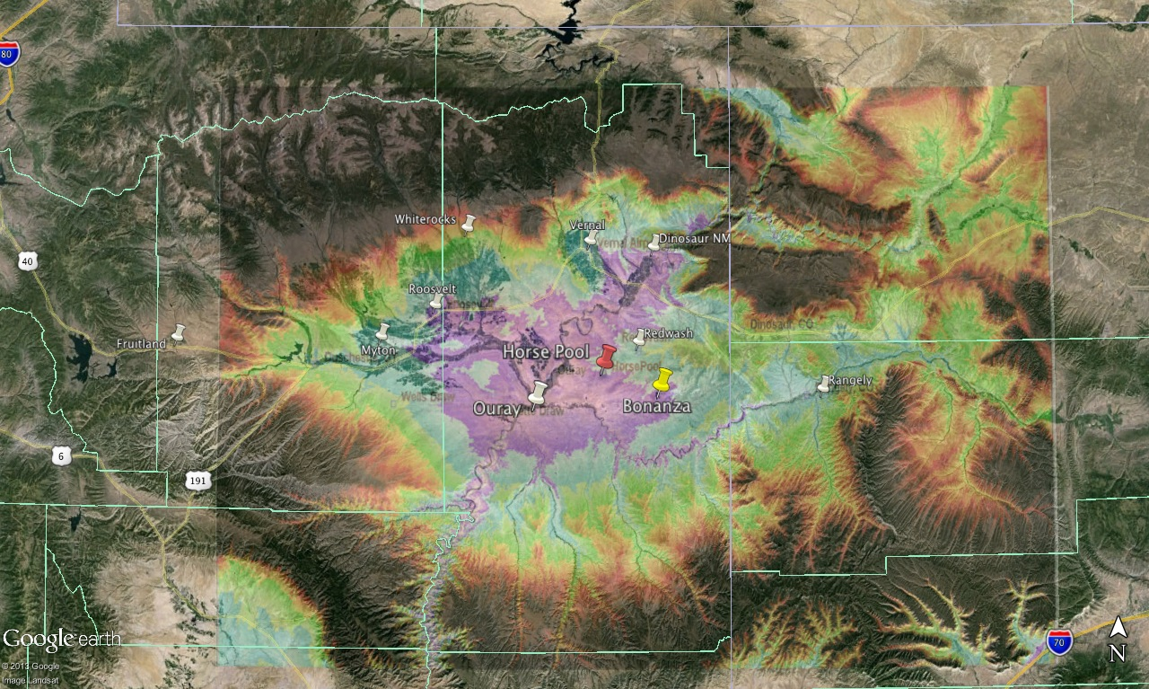
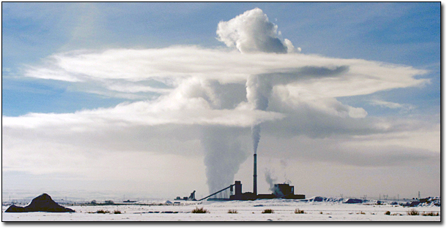
TOLNet/NOAA/ESRL TOPAZ
High wintertime ozone in an oil & gas region
TORONTO
AMES
ESRL
GSFC
JPL
LaRC
UAH
Horse Pool
UT
CO
TOPAZ: 14/15 Feb 2013
< 60 ppbv O₃ aloft
Bonanza Power
Plant
Bonanza power plant plume
Cold pool layer
> 10,000 active oil
and gas wells
Uintah Basin, UT
High O₃ concentrations were confined to a 400-m deep cold pool layer.
Bonanza power plant emissions did not mix down to the surface.
No indication of long-range or stratosphere-to-troposphere transport of elevated O₃.
Local emissions from oil & gas extraction are the main driver of high O₃ concentrations.
Notes:
High snow albedo combined with oil/gas field sources of Nox and VoC react photochemically to result in high ozone amounts in the shallow wintertime PBL in Uintah Basin, UT.

Slide 27
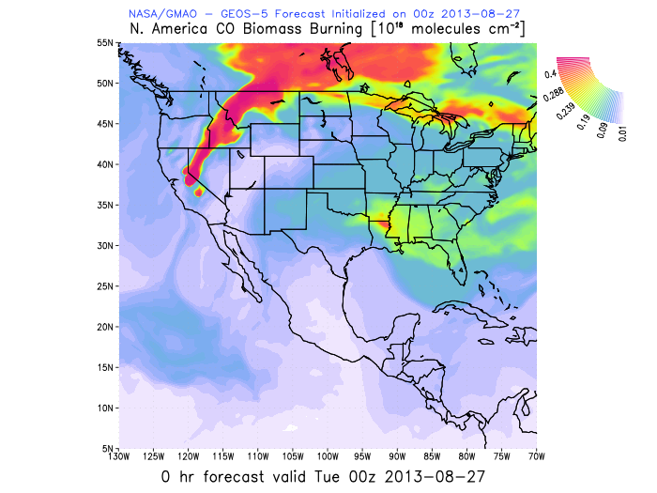
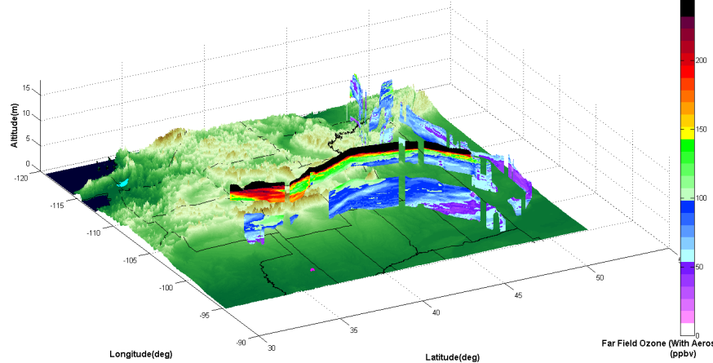
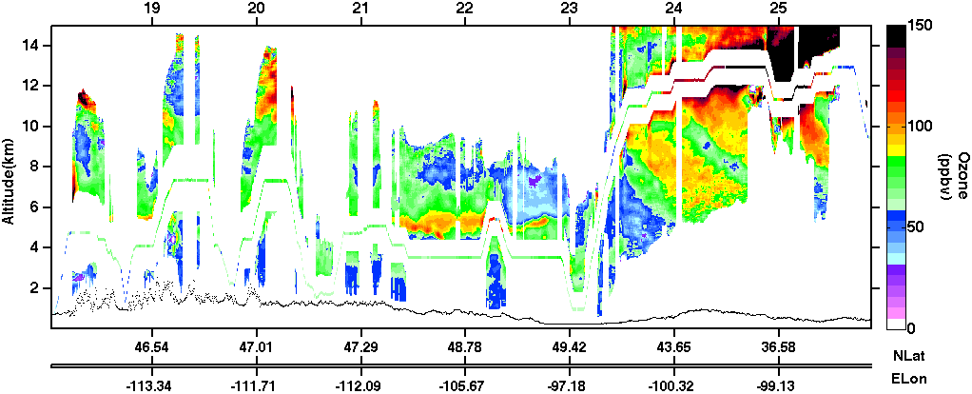
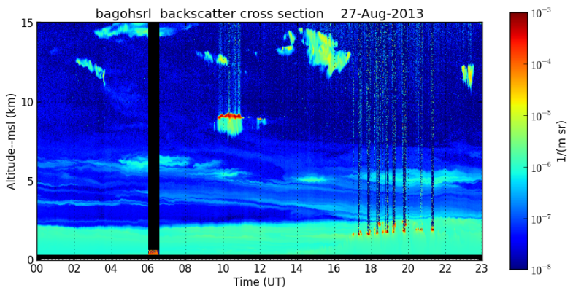
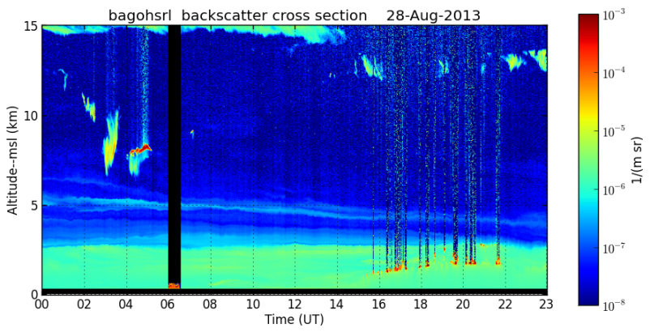

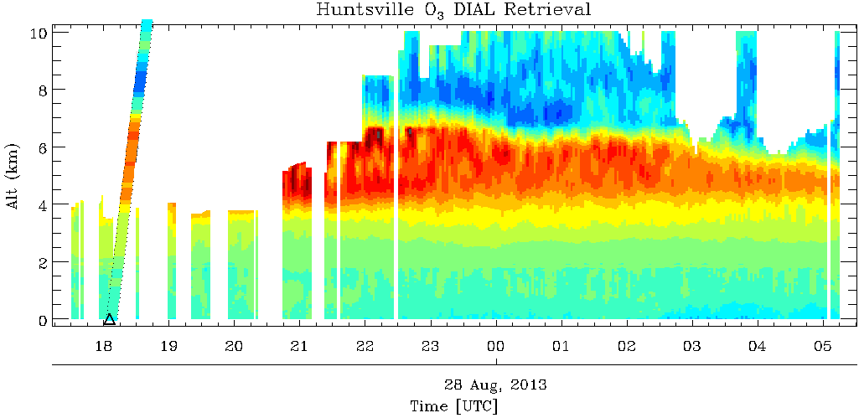
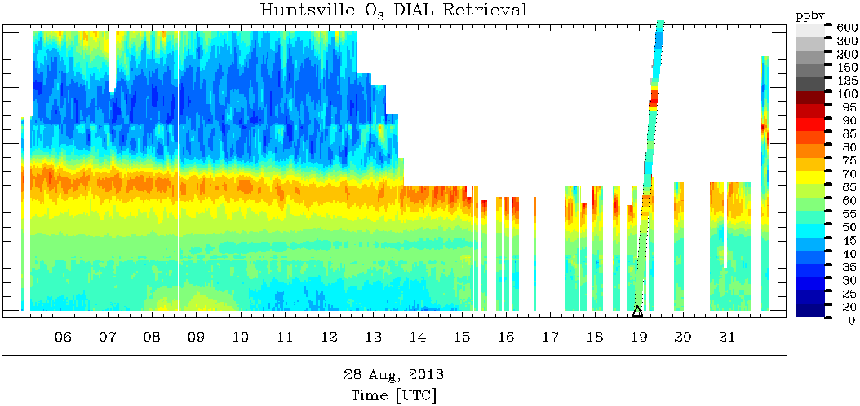
TOLNet/UAH RO₃QET: CA wildfire detection by airborne LaRC/DIAL&HSRL, RO₃QET, and UW-HSRL over Huntsville
TORONTO
AMES
ESRL
GSFC
JPL
LaRC
UAH
LaRC-DIAL O3
LaRC-HSRL aerosol
8/27 00z GMAO CO
UW-HSRL aerosol
RO₃QET O3
8/27
8/28
Notes:
The airborne (DC8) LaRC HSRL & DIAL (John Hair) measuring ozone and aerosol in conjunction with UW HSRL (Ed Eloranta) collocated the TOLNet-UAH RO3QET ozone lidar in Huntsville, AL provides a very detailed picture of the elevated ozone and aerosol laminae resulting from California wildfires.

Slide 28
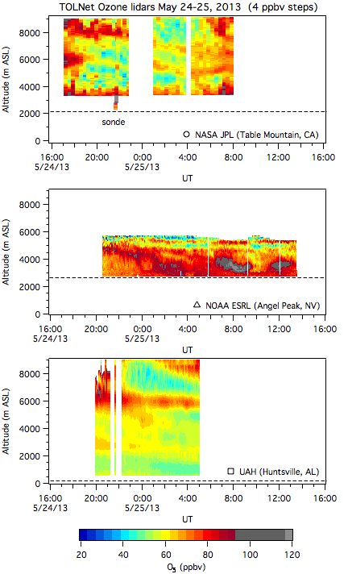
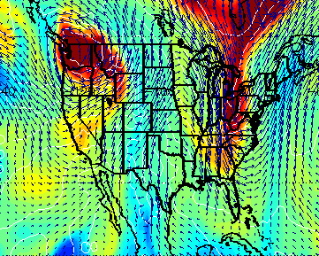
TMF, TOPAZ, & RO₃QET measure two continental-scale stratospheric folds
TORONTO
AMES
ESRL
GSFC
JPL
LaRC
UAH
TMF
Note the ESRL obs was made at Las Vegas.
(LeBlanc)
310K (≈2 to 4 km ASL)
(Senff, Langford)
ESRL
UAH
(Newchurch, Kuang)
May 24, 2013 12UT RAQMS 310-K ozone
Brad Pierce (NOAA/NESDIS)
Lidar measurements
Notes:
Simultaneous tropopause folds above the eastern and western U.S.
Ozone lidars can provide information about small-scale features of stratospheric intrusions (SI).
Ozone lidar networks can provide synoptic view of large-scale features of SI.

Slide 29



The NASA 2017 Ozone Water-Land Environmental Transition Study (OWLETS): Highlights from NASA GSFC
John T. Sullivan (…and many others)
Results within are preliminary, please contact relevant Data PI for more info on data

Slide 30
NASA Sherpa July 20:
Look at the costal gradients!
Look at the land-sea ozone gradients
LaRC
CBBT
Data below 500m from ~11a to 2p
Also: NOx (S. Pusede), GHG (Wolfe/Hanisco/St. Clair), and VOCs (D. Blake)
Notes:
Model: Linked numerical prediction system
Operationally integrated on NCEP’s supercomputer
NOAA/EPA Community Multiscale Air Quality (CMAQ) model
NOAA/NCEP North American Mesoscale (NAM) numerical weather prediction
Observational Input:
NWS compilation weather observations
EPA emissions inventory
Gridded forecast guidance products
On NWS servers: airquality.weather.gov and ftp-servers (12km resolution, hourly for 48 hours)
On EPA servers
Updated 2x daily

Slide 31
Lidar Differences: 7/21
Differences Between Sites
Over Water, CBBT
1.
3.
4.
2.
On Land, LaRC
Meteorological and chemical simulations will improve analyses – local vs. regional transport?
Notes:
Both data were retrieved with identical algorithm, specs, vertical smoothing, temporal averging. 5 -mins
More prominent residual layer(s) aloft over land than over water.
Morning O₃ is depleted over water much more than over land
O₃ formation occurs more rapidly and mixes to higher altitudes over land than over water.
Onset of peak O₃ over water is markedly later and higher concentration than over land, suggesting aged air mass advected to the over land site

Slide 32
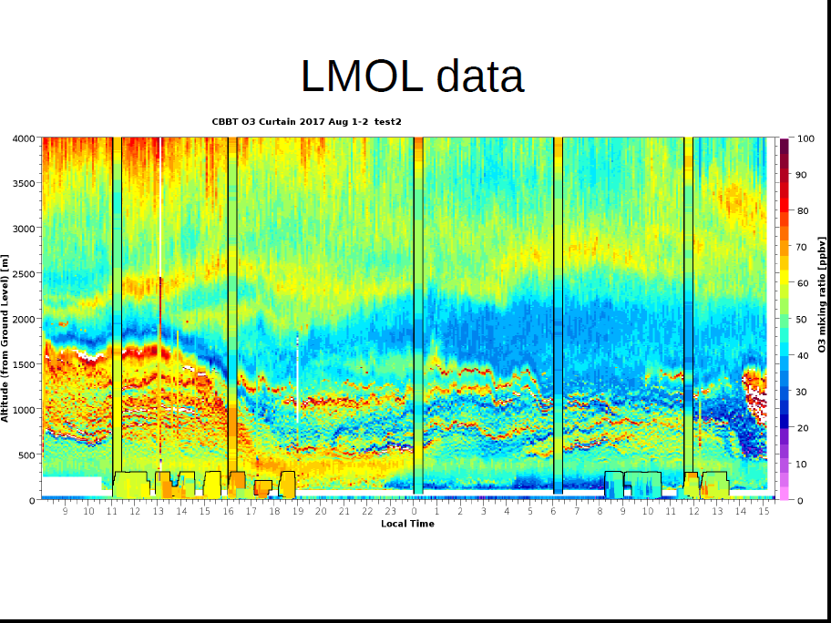
Preliminary LaRC Mobile Ozone Lidar Data
Note the spatio-temporal structure
Notes:
Both data were retrieved with identical algorithm, specs, vertical smoothing, temporal averging. 5 -mins
More prominent residual layer(s) aloft over land than over water.
Morning O₃ is depleted over water much more than over land
O₃ formation occurs more rapidly and mixes to higher altitudes over land than over water.
Onset of peak O₃ over water is markedly later and higher concentration than over land, suggesting aged air mass advected to the over land site

Slide 33
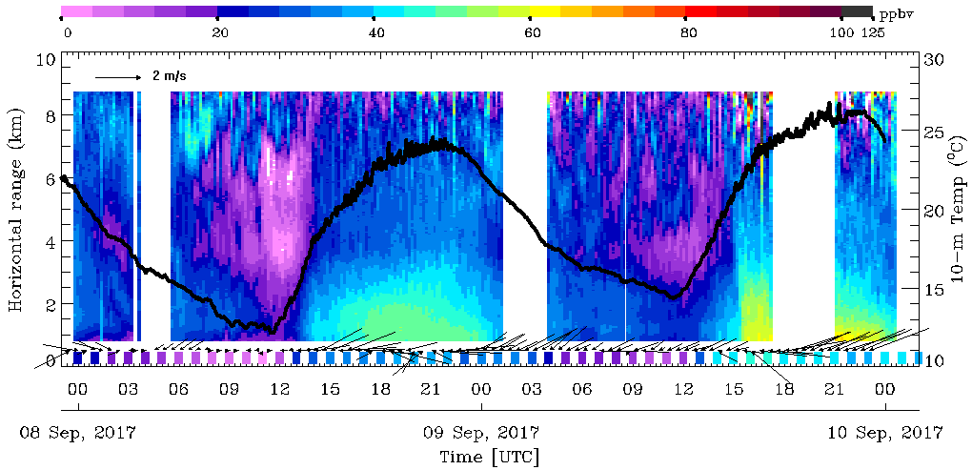
Horizontal O₃ Gradients Measured on Sep. 7-10, 2017 by
RO3QET Lidar in Huntsville
Within 1 or 2 TEMPO Pixels
UAH 10-m T from Prof. Kevin Knupp
Airport rd. EPA

Slide 34
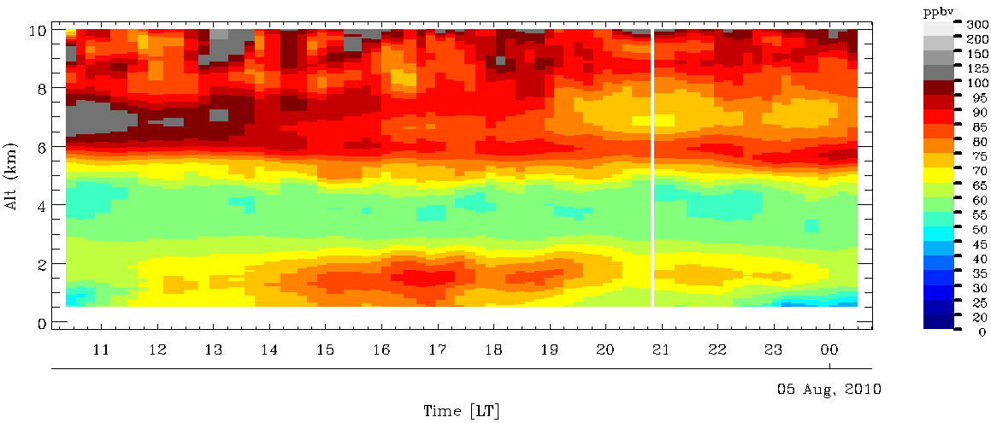
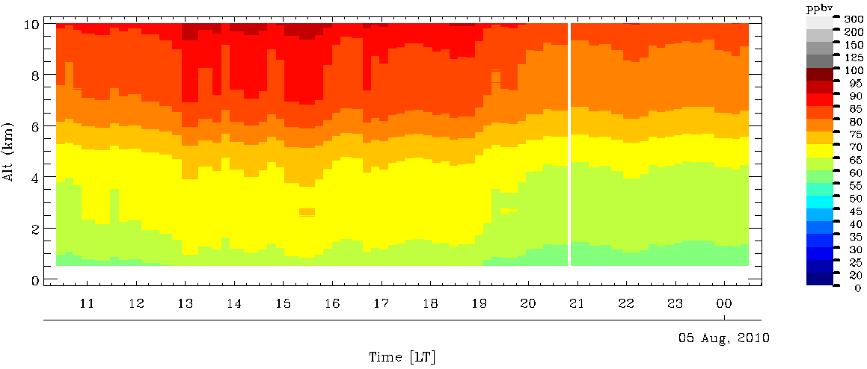
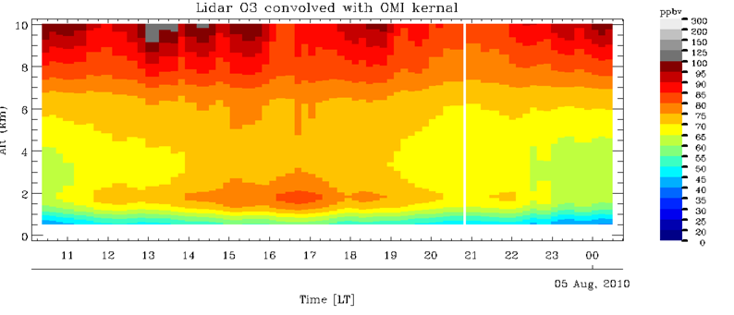
TORONTO
TOLNet Complements TEMPO
GSFC
AMES
ESRL
LaRC
JPL
UAH
TOLNet/RO₃QET observation at Huntsville on Aug. 4, 2010. Note distinct upper troposphere and PBL layers.
RO₃QET observation convolved with TEMPO UV averaging kernel to simulate the space-borne observation, which captures most of the UT layer but little of the PBL.
RO₃QET observation convolved with TEMPO UV & Visible enhances the fidelity of both UT and PBL layers, but does not capture the lowest 1km very well. X. Liu et al.
Conclusion: TOLNet provides measurements to not only validate TEMPO, but also to complement TEMPO, especially in the PBL.
Notes:
Top slide: the “truth” as measured by high spatio-temporal-resolution lidar.
Middle: What TEMPO will see with only UV retrieval.
Bottom: What TEMPO will see with both UV and Visible retrieval, but the visible part of this retrieval is difficult and dependent on knowledge of albedo and other geophysical variables.
Conclusion: TOLNet provides measurements to not only validate TEMPO, but also to complement TEMPO, especially in the PBL.

Slide 35
David Parrish/ESRL: Estimating Baseline Contributions to Surface Ozone in California’s Central Valley
TORONTO
AMES
ESRL
GSFC
JPL
LaRC
UAH
Surface O₃ in North Sacramento Valley enhanced due to inflow of higher altitude air
San Joaquin Valley surface O₃ evolution consistent with similar inflow into that valley as well
TOLNet observations could provide direct evidence for that inflow
Implication:
Higher O₃ in San Joaquin Valley than South Coast Air Basin means that the Nation’s O₃ pollution problem is no longer predominately a large city problem; it now can be worse in rural areas!
Notes:
Inflows and circulations are critical.
TOLNet can measure those processes.

Slide 36
Geo TASO &
ACAM/GCASJay Al-Saadi

Slide 37
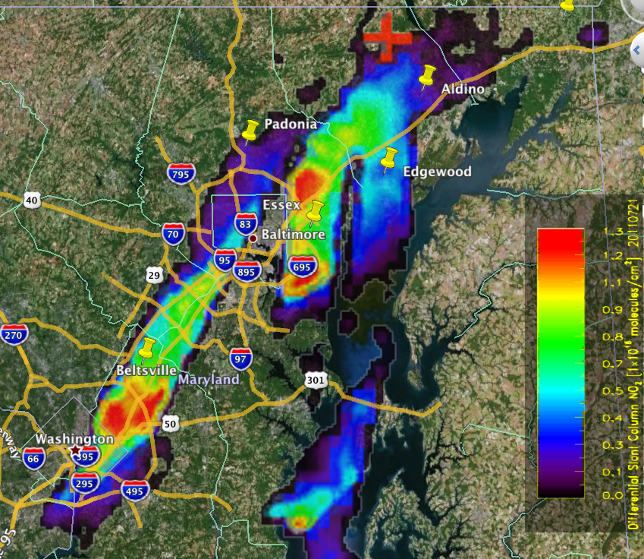
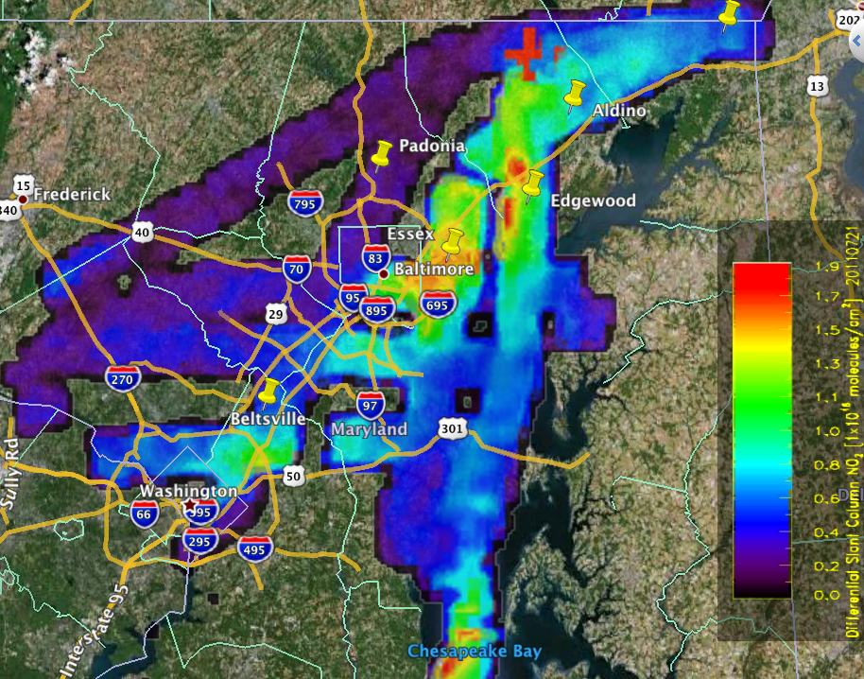
ACAM Spatial/Temporal Variability NO₂ July 21st
MD Deployment
Morning
0.005° x 0.005° grid of 3 km² average, differential slant column abundance. “Clean scene” reference at cross.
Afternoon

Slide 38
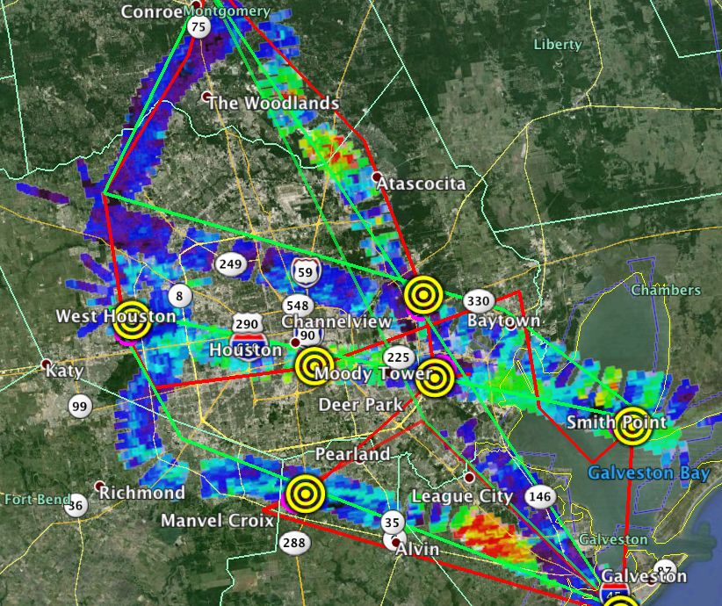
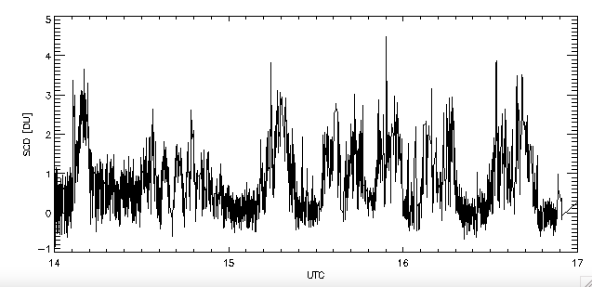
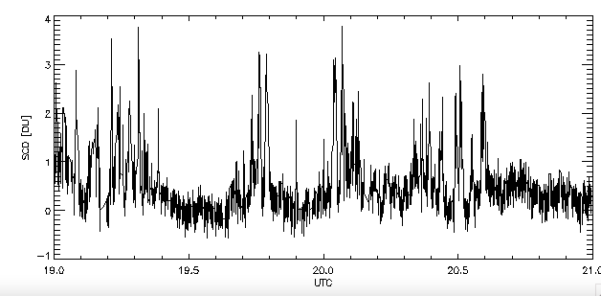
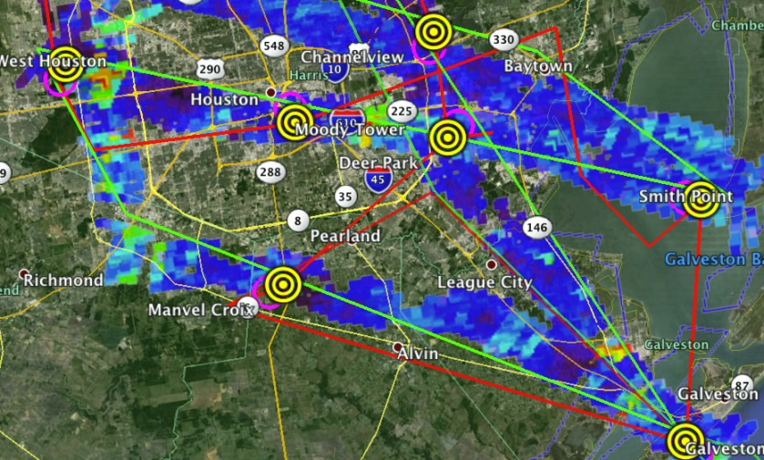
GCAS CH₂O Sept. 24th
Houston deployment
Morning
Afternoon
Highest levels of CH2O seen of the four deployments. Comparisons with DFGAS complicated by cloud interference.

Slide 39
NO₂
Ron Cohen See Josh Laughner poster

Slide 40
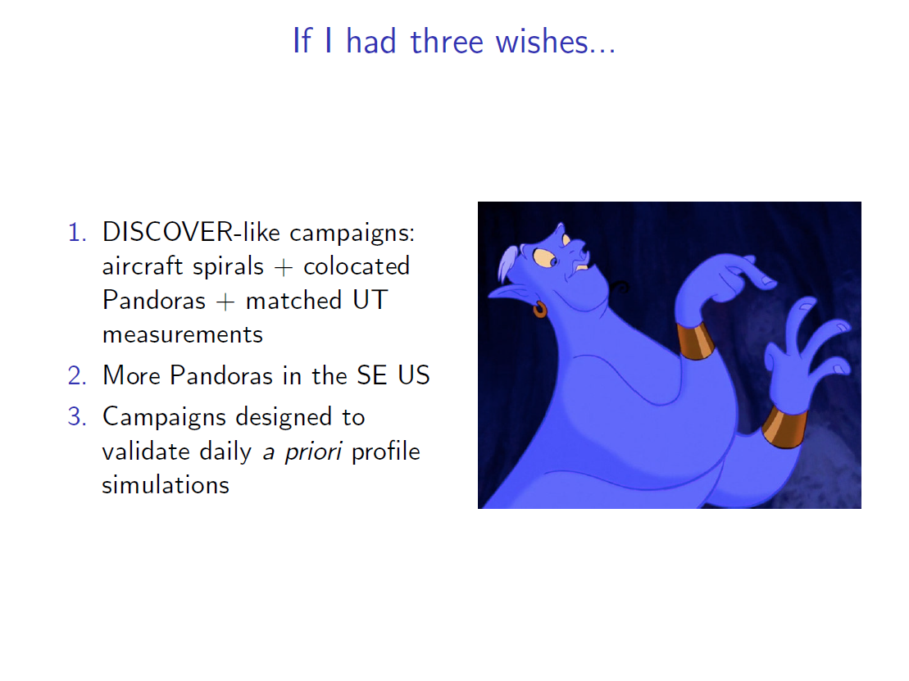
Ron Cohen

Slide 41
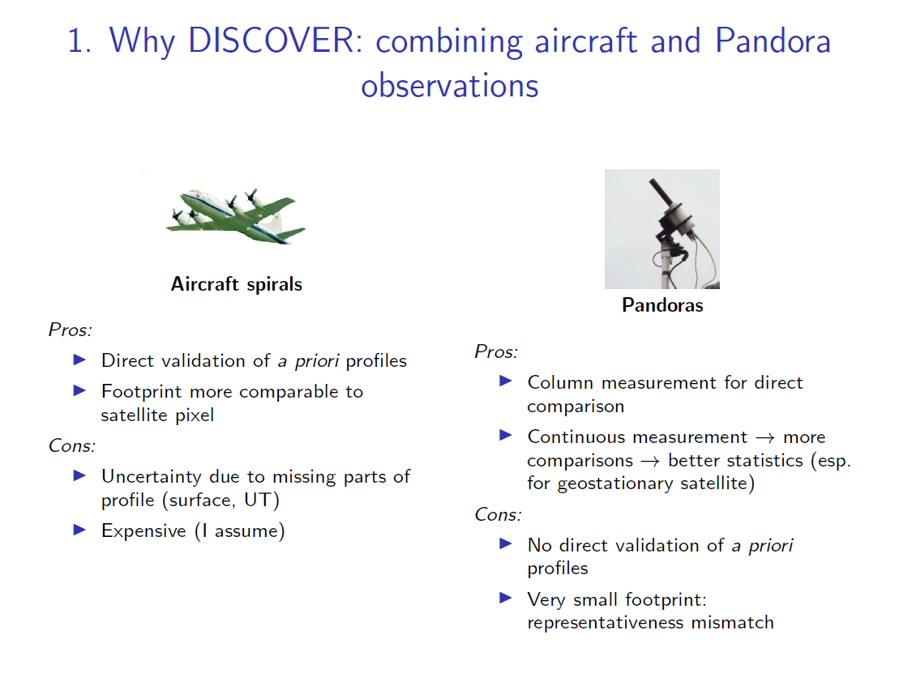
Ron Cohen

Slide 42
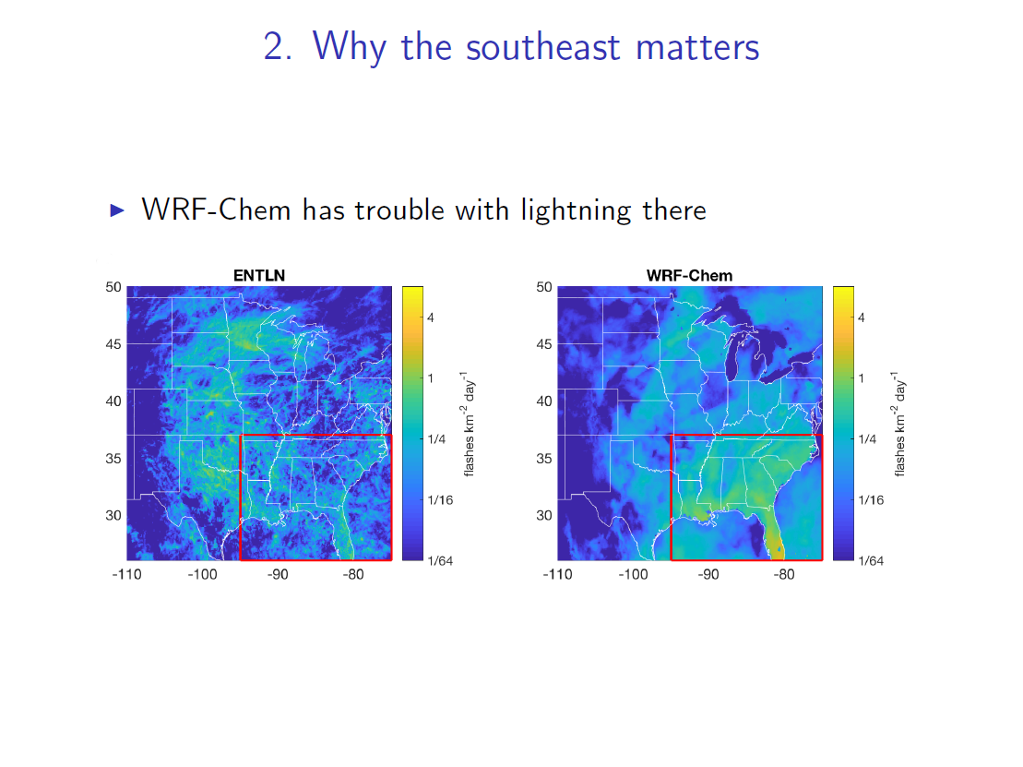
Ron Cohen

Slide 43
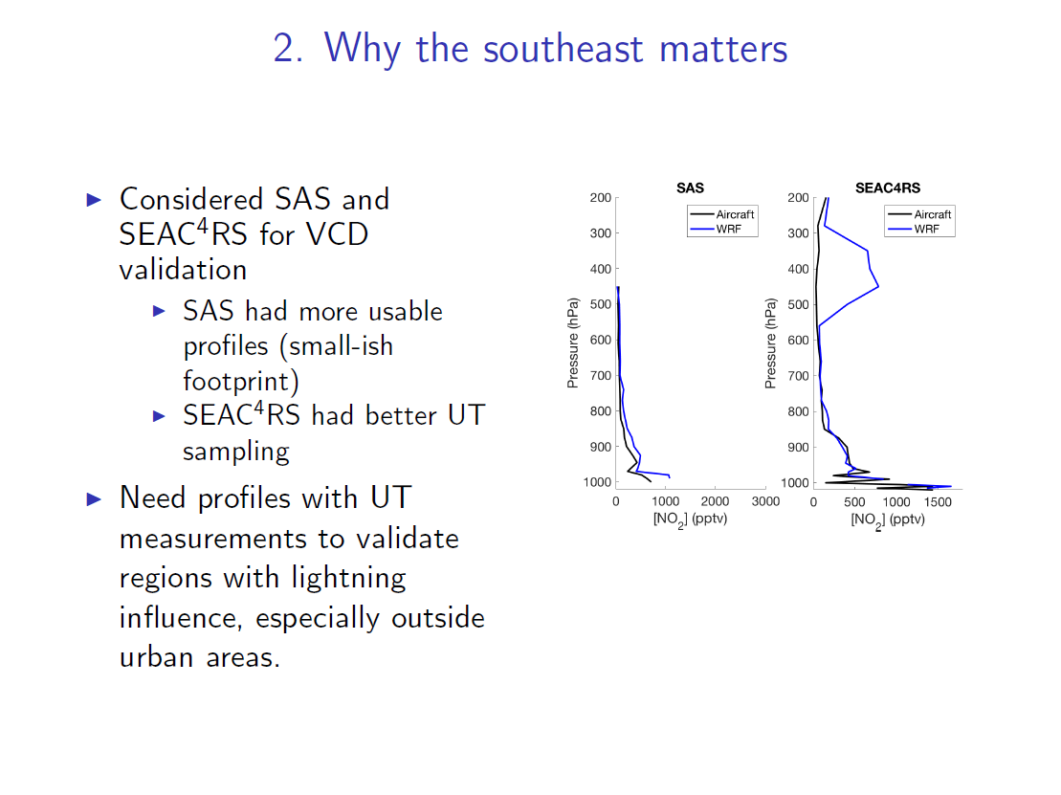
Ron Cohen

Slide 44
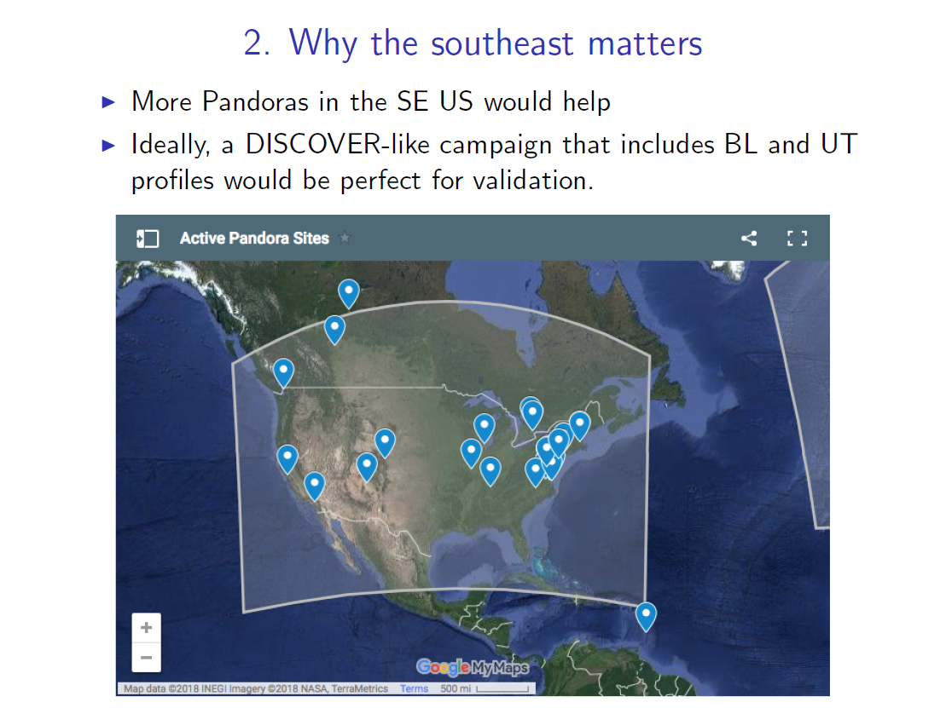
Ron Cohen

Slide 45
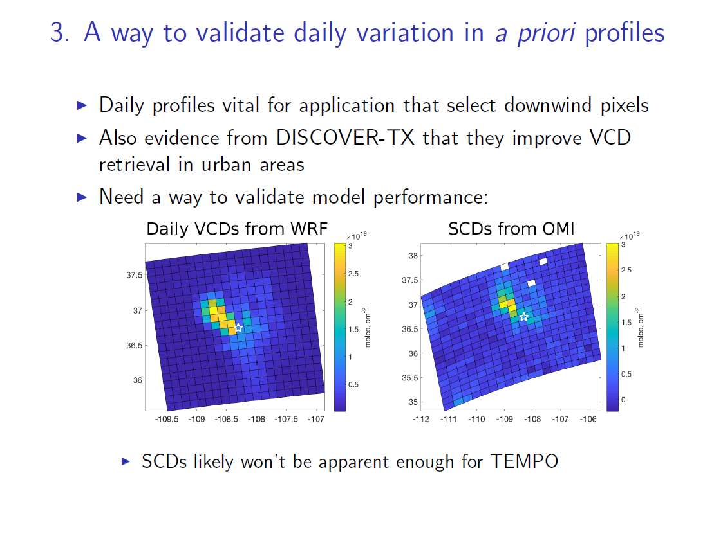
Ron Cohen

Slide 46
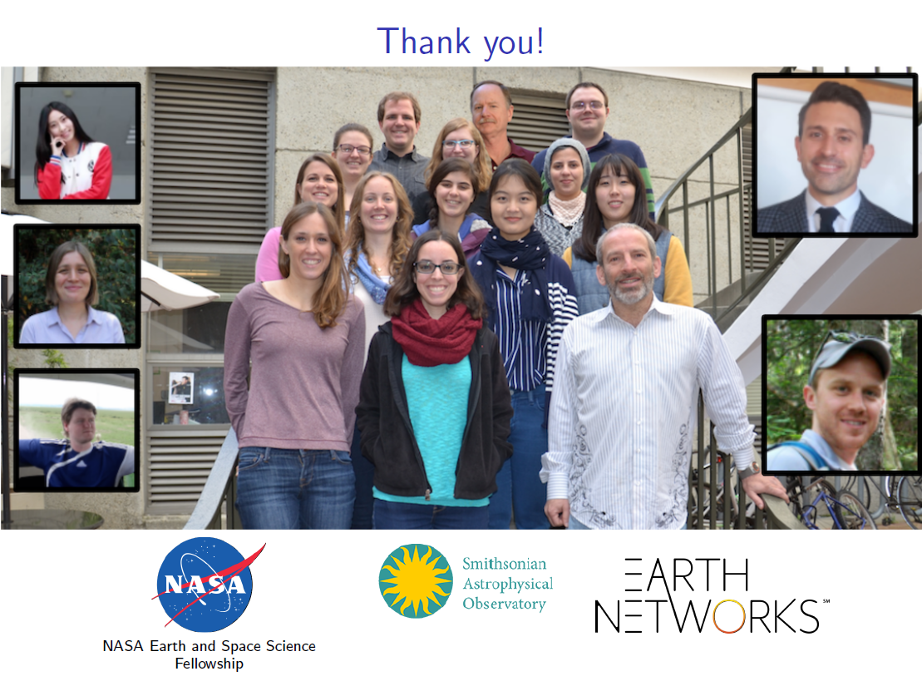
Ron Cohen’s Group

Slide 47
Formaldehyde

Slide 48
CH₂O Validation Challenges
Validation challenges for TEMPO CH₂O column measurements:
Adequacy (or lack) of correlative measurements - vertical distribution (especially within the BL)
Impact a priori vertical diurnal profiles
Aerosols and clouds
Albedo changes and spatial gradients
Sources of independent sources of CH₂O measurements:
Satellite data sets from independent sensors: TropOMI
Aircraft observations; GCAS, GeoTASO, Aircarft in-situ profiles
Ground-based measurements; Pandora
For CH₂O a-priori vertical profile shapes have the largest systematic impact on the satellite column errors due to the strong decrease of the satellite UV measurement sensitivity near the surface.

Slide 49
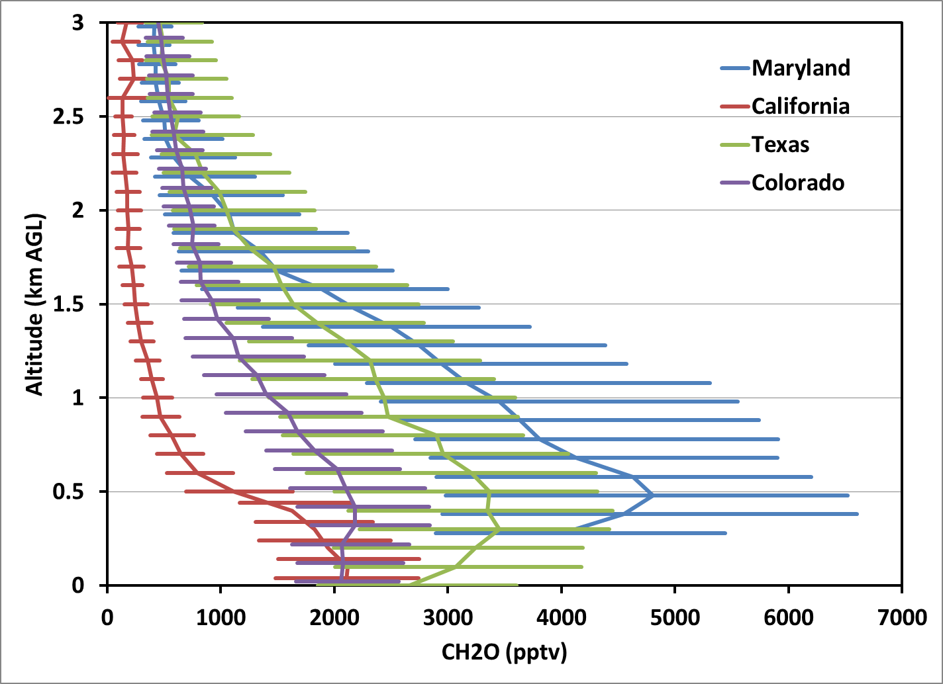
DISCOVER-AQ
P-3 Median CH₂O Profiles
49

Slide 50
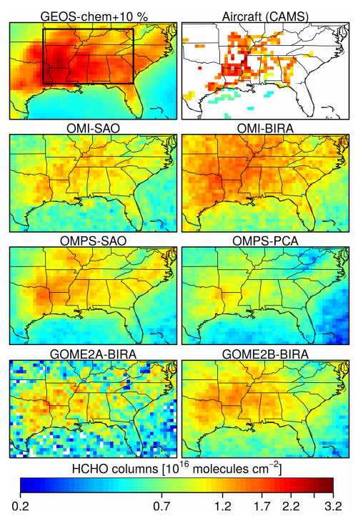
Zhu et al., ACP 2016
Fig. 5 from Zhu et al.
Top row, left: HCHO columns from GEOS-Chem simulation optimized to match aircraft observations
Top row, right: HCHO columns calculated from aircraft observations
Bottom panels: retrievals from 4 satellites (OMI, OMPS, GOME2A, GOME2B) with two groups’ retrievals each for OMI and OMPS
All satellite observations report lower HCHO columns than GEOS-Chem or aircraft observations

Slide 51
Federated Networks
Jim Szykman

Slide 52
Rationale for pursuit of a Federated Activity for TEMPO L2/L3 Validation
A federated approach to validation/evaluation of L2/L3 geophysical variables using existing air quality network infrastructure could help promote early acceptance of L2/L3 data products, especially given the potential short operational life of TEMPO.
Current proposed changes by the EPA to the existing Photochemical Assessment Monitoring Station (PAMS) Network provides a unique opportunity to:
  Leverage existing/expanding infrastructure already required and funded by EPA via the Clean Air Act.
  Develop continuous (24/7) TEMPO correlative data validation sites in the areas with the worst O₃ pollution.
  Help foster more significant interaction between TEMPO science team and the air quality agencies.
  Build on existing AQ long term datasets in urban areas, and make TEMPO data products more relevant to air quality managers.

Slide 53
TEMPO relevant changes under PAMS Network Re-Engineering
At EPA we've been busy with our effort to support the Long Island Study Tropospheric Ozone Study (LISTOS; June-Aug) and combining the LISTOS effort with long term deployment of Pandoras in support of the new PAMS Enhanced Monitoring Plan requirement and TROPOMI validation. We see these efforts eventually feeding into TEMPO validation in the out years.
This past week we had two EPA teams, along with great support from the NASA Pandora Project, deploy a total of nine pandoras across the greater Long Island Sound Region. Prior to this we also deployed seven BEACON nodes in a dense network around the greater NYC area also in support of LISTOS. All pandoras and BEACONs are co-located at existing air-quality stations run either by NJDEP, NYDEC, or CTDEEP with the exception of the pandora located on Outter Island in the Sound and managed by the USFWS. The kmz files shows the locations of the pandoras and the BEACON pods (I've include the CCNY's pandora too, so there are actually 10 across the region). Seven of the nine pandora will continue as long-term units supporting the new EPA requirement for Enhanced Monitoring within the Ozone Transport Region (VA to ME) and also in support of TROPOMI validation. This will provide a great data set over the next several years as we move towards TEMPO validation.
Also as you have probably seen, we have worked in collaboration with Elena on a pandora HCHO manuscript from KORUS-AQ which is in AMTD, (https://www.atmos-meas-tech-discuss.net/amt-2018-57/). This manuscript begins to address one of the issues related to validation of HCHO from TEMPO and is also important for our effort under PAMS as we being to work with the states on use of NO2/HCHO trop columns from Pandoras for use in AQ analysis.
Finally, at EPA we have a current effort to evaluate commercially available continuous HCHO measurements in support of both the PAMS and National Air Toxics programs. Based on what we are seeing and hearing, it is very likely that a commercially viable continuous HCHO instrument will be available before TEMPO launch and the states will likely start swapping out from TO-11 to a continuous HCHO instrument in the coming years. Some states are already programing resources for this starting next year. Another piece of good news for TROPOMI and TEMPO validation.
The bottom line is that the EPA PAMS measurements over the coming year should provide a nice set of baseline measurements very relevant to TEMPO validation needs. We are also working with our EPA colleagues in our CASTNet program to extend Pandora measurements to a subset of their sites in support of TROPOMI, so these sites can serve as background or regional sites for validation.

Slide 54
Thoughts from Jim Crawford on Possible Approaches
There are at least two initial approaches to take.
One is to leverage what we have learned from DISCOVER-AQ, KORUS-AQ, etc. to define a field campaign to support TEMPO. In this case, you would hope to be able to get airborne as soon as possible after TEMPO launches.
Another approach would be to get the right surface measurements in place and use them to identify the locations where TEMPO needs the most help. This would delay a field campaign in favor of getting a chance to evaluate TEMPO performance using ground obs, sondes, Pandora, TROPOMI, etc. Such a campaign would hopefully be more targeted on TEMPO performance, but would also hope to see TEMPO observations continue beyond the initial 2-years to take advantage of what is learned.

Slide 55
Jim Crawford:
So what do we do?
  Science studies related to TEMPO observations are a logical priority for tropospheric chemistry programs post-launch
    Analysis of DISCOVER-AQ, KORUS-AQ, TROPOMI and other data sets will help clarify priorities for pre- & post-launch airborne campaigns related to TEMPO
    Spatial representativeness, diurnal influences on products, vertical profile shapes, …
  Get in line and build advocacy: NASA campaign concepts typically start as community grass-roots efforts leading to development of white papers
  Consider Earth Venture proposal?
  Continue preparatory activities as funding permits (GEO-CAPE, HQ R&A, possibly HQ Applied Science, possibly TEMPO)

Slide 56
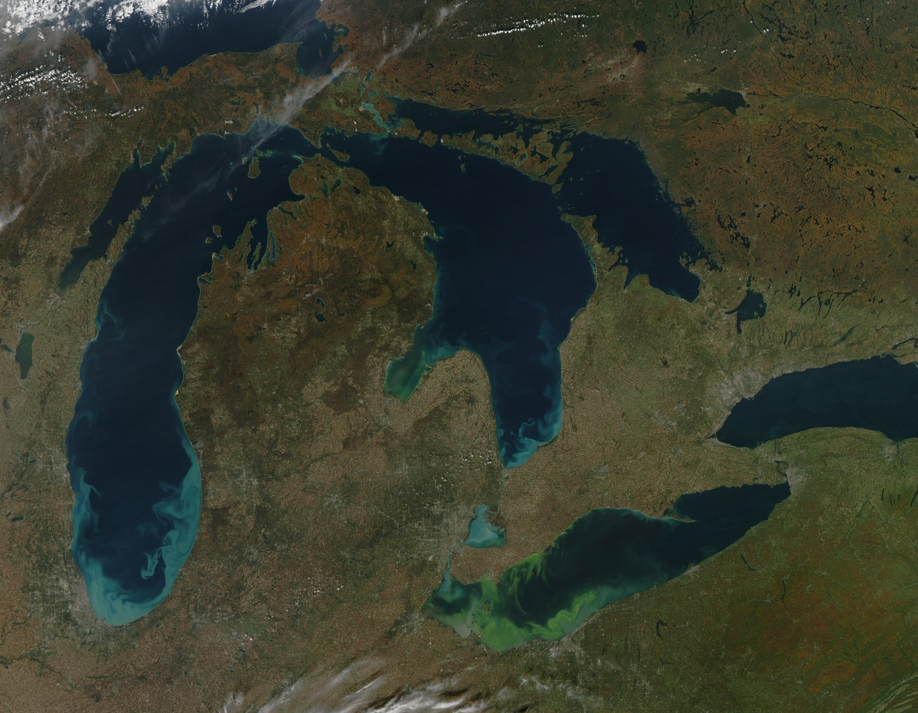
Great Lakes
• wind-driven sediments
(blue) &
& algal blooms (green)
• in situ measurements in
Lake Erie identified
Microcystis aeruginosa,
algae that produces
microcystin, a liver toxin
•toxic blooms in the Great
Lakes pose problems for
safe drinking water
availability for coastal
communities
• 9 October 2011
MODIS Image
Do we want to validate TEMPO products
over the water?
•image available at
http://earthobservatory.nasa.gov/IOTD/view.php?id=76115&eocn=image&eoci=related_image

Slide 57
Conclusions
Observations from a variety of instrument (Pandora, Geo TASO, ACAM/GCAS, TOLNet, DISCOVER-AQ, et al.) of the TEMPO species demonstrate significant temporal and 3-d spatial variability in the trace species. Mapping these spatio-temporal gradients onto the TEMPO observation kernels will be critical for quantitative validation.
Pandora, the primary validation instrument, is maturing well and propagating across the continent.
Geo TASO and ACAM/GCAS a/c simulator data well characterizes the spatial and temporal variability of trace gases
TOLNet is also maturing well and provides excellent observations of the high-fidelity spatio-temporal evolution of tropospheric ozone
Federated networks making correlative observations will provide valuable validation
Modeling activities (i.e., assimilation, spatio-temporal gradients, attribution, climatologies, etc.) are not directly supported by TEMPO validation, but are critical to assess our understanding of the TEMPO observations.
The minimum-required Pandora validation is reasonably tractable, but any additional activities, especially validation campaigns will require additional resources: It is time to build the constituency (cf., Jim Crawford).

Slide 58

So, take the bull by the horns
and get to work.

